Slide 1
Django Rest API

Slide 2
Whatis an API???????
Application Programme Interface (communicate the programmers to various applications)
Applications : games,social network apps any programming applications.
Programme : Set of instructions that tell you a computer to do a specific task.
Interface : A point where two applications or you can see two programs meet and interact with each other .

Slide 3
What is an API????
It is a set of subroutine ,definitions,protocols and tools for building applications software.
It helps in connecting various software components.
API is a software intermediary that allows two applications to talk to each other. Each time you use an app like Facebook, send an instant message, or check the weather on your phone, you're using an API.

Slide 4
What Is a REST API?
A REST API is a way for two computer systems to communicate over HTTP in a similar way to web browsers and servers.
Sharing data between two or more systems has always been a fundamental requirement of software development.

Slide 5
What is Rest API????
When web services use REST architecture ,they are called REST API.
A REST API is a set of web addresses that respond with pure information,not a formatted web page.
An API returns a JSON format data always,key-value pair.

Slide 6
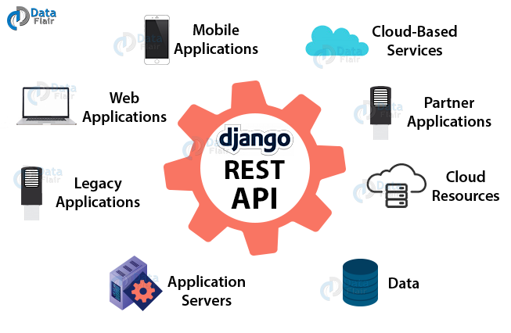

Slide 7
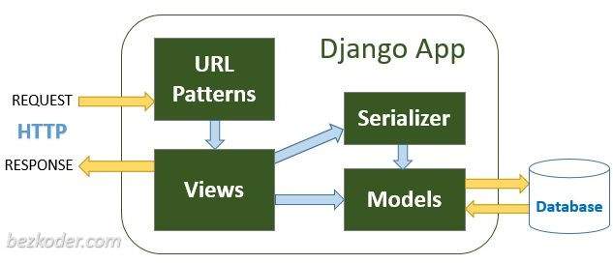
Django Rest Api Architecture

Slide 8
Django Rest Api Architecture
HTTP requests will be matched by Url Patterns and passed to the
Views.
Views processes the HTTP requests and returns HTTP responses (with the help of Serializer).
Serializer serializes/deserializes data model objects.
Models contains essential fields and behaviors for CRUD Operations with Database.

Slide 9
Rest Framework
It describes an architecture which stands for representational state transfer.
It used for web based architecture for data communication.
It uses HTTP to make calls between machines.
HTTP Methods :
Get : Retrive a Resource
Put : Change/Update a Resource Post : Create Resource
Delete : Deletes a Resource

Slide 10
Installation
Install using pip, including any optional packages you want...
pip install djangorestframework
Add 'rest_framework' to your INSTALLED_APPS setting.
INSTALLED_APPS = [
...
'rest_framework',
]

Slide 11
JSON DATA
JSON: JavaScript Object Notation.
JSON is a syntax for storing and exchanging data.
JSON is a lightweight data-interchange format
JSON is "self-describing" and easy to understand
JSON is language independent

Slide 12
Difference b/w API & RestAPI
REST basically is a style of web architecture that governs the behavior of clients and servers.
While API is a more general set of protocols and is deployed over the software to help it interact with some other software. REST is only geared towards web applications. And mostly deals with HTTP requests and responses
In other words
There is no comparison in REST and API, REST is an API type.
API, in general, is a set of protocols deployed over an application software to communicate with other software components (Like browser interacting with servers) and provide an interface to services which the application software offers to several live consumers.
And Rest is a form of principle which an API follows in which the server provides information whatever the client desires to interact with services.

Slide 13
JSON DATA
1. {
2. | "employee": {
3. | "name": | "sonoo",
4. | "salary": | 56000,
5. | "married": | true
6. | }
7. }

